Slide 1
Fentanyl Crisis in the U.S. Cornelius Wilnhammer WK English for Health Economics matriculation number: 29841525 Date: 16th June 2025

Slide 2
structure
What is fentanyl?
Opioid crisis
Problems / Impact on health system
Measures
Conclusion + Discussion

Slide 3
What is fentanyl?

Slide 4
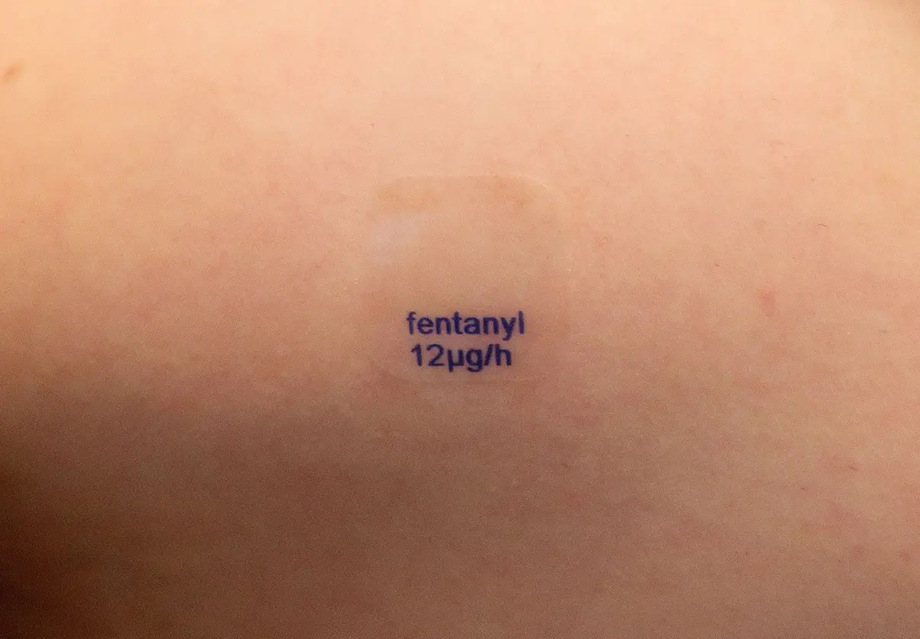
- synthetic opioid - use: pain management and anaesthesia - 50 to 100 times stronger than morphine - clinical use since 1968 - delivered via intravenous or transdermal routes - side effects: dizziness, vomiting, orthostatic hypotension, euphoria, respiratory depression - problem: high abuse potential - risk: rapid onset of rigidity in critical muscle groups, including respiration → death
What is fentanyl?
https://img.nzz.ch/2025/05/09/38db81b7-8372-4ce3-bdc8-0c66e77c2a16.jpeg?width=1207&height=839&fit=bounds&quality=75&auto=webp&crop=1804,1253,x90,y142
https://s.hdnux.com/photos/01/40/65/71/25386571/3/ratio3x2_960.webp
Notes:
Fentanyl is a synthetic opioid, which means that it can be produced with chemicals in a laboratory. According to the faculty of Medicine at John Hopkins University, opioids are a class of drugs that work as painkillers, specially for surgery patients and a specific group of patients experiencing excruciating pain due to trauma, disease or cancer. Since 1968 fentanyl is used in clinical contextes as pain management and anesthesia. Ist analogous to morphine, but with a 50 to 100 times higher analgesic effect. Mostly, in clinical practice, fentanyl is delivered via intravenous or transdermal routes, e.g. as a patch.
The side effects of fentanyl are comparable to those of other opioids: dizziness, vomiting, orthostatic hypotension, euphoria or respiatory depression.
The problem is that, fentanyl has a high abuse potential. A characteristic manifestation of its use is known as the „fentanyl fold“; due to a loss of muscle control people bend over in unusal position.
Furthermore in case of overdose it rapidly causes rigidity in cirtical muscle groups, including those involved in respiration, which, in worst case, can lead to death.

Slide 5
Opioid crisis

Slide 6
- many drug problems over the last century - 2022: 108,000 deaths from drug overdose, 82,000 of those involved opioids - more than 500,000 opioid-involved deaths since 2000 in US - highest number of opioid-involved deaths per capita - particularly high among people ages 24 to 35
Opioid crisis
Increased demand for opioids for self-medication
Increased prescription of opioids
Greater consumption of opioids from illegal sources
Opioid crisis
Notes:
The United States has experienced many drug problems over the last century. There are acutally three waves of opioid overdose deaths: The first wave began in the late 1990s when doctors over-prescribed opioid like Oxycontin to their patients, even if the conditions were less severe. This was also driven by big pharma who wanted to increase their sale. The second wave occured when these patients became dependent on opioids but could not get prescriptions to buy them, so they turned to cheaper and more accessible drugs on the illegal market, mainly heroin. With 2010 the nubmer of deaths due to heroin rose rapidly. The third wave occured with the appearence of a new synthetic opioid on the market: called fentanyl. Even two milligrams of fentanyl is enough to kill an average-sized person.
As you can see on the graphic, the number of opioid overdose deaths increased especially with the appearence of synthetic opioids.
In 2022 only in the US, about 108.000 people died from drug overdose and 82.000 of them involved opioids. That means that each day 224 people died from an opioid overdose. So the number is 10 times the number in 1999.
Since 2000 over 500,000 opioid-involved deaths were registrated in the US which leads to the fact, that the US has the world‘s highest number of opioid-involved deaths per capita.
The number of deaths is particularly high among people ages 24 to 35.
According to the congressional budget office, the main reasons for the opioid crisis in the US are an increased prescription of opioids, due to aggressive promotion and increased tratements of pain; increased demand for opioid for self-medication as a result of economic and social determination; and greater consumption of opioids from illegal sources because of increased nonmedical use and larger supply of heroin, fentanyl, and other substances.

Slide 7
Why exactly fentanyl? - Potency and lower costs in production and import - 8 to 12 percent of patients develop Opioid Use Disorder (OUD)
Opioid crisis
Notes:
But why exactly is fentanyl this popular?
The potency and the cheap production costs of synthetic opioids in general but particularly fentanyl, make them attractive alternatives for drug dealers. Pardo and Reuter estimated, that at the import level, fentanyl is 99 percent cheaper per dose than heroin. Much of the chemicals used to produce fentanyl come from abroad, mostly China. Producers are therefore outside the reach of the US law enforcement. In addition, five grams of fentanyl are equivalent to 150 grams of pure heroin and are worth about 10.000 dollars.
Often users are not aware of the risk to become dependent, to give you a number; about 8 to 12 percent of patients who take prescription opioids for chronic pain do develop Opioid Use Disorder (OUD).

Slide 8
Problems / Impact on health system

Slide 9
- Increased amount of people with OUD - Increased incidence of related diseases (Hepatitis C and HIV)
Problems / Impact on Health system
Notes:
First of all the opioid crisis has increased the amount of people with OUD, which means the number of people who access therapie raises and the number of opioid-involved deaths. In addition the incidence of related diseases like Hepatits C and HIV increased too, same as the number of newborns experiencing neonatal withdrawl as a result of their mothers‘ opioid muisuse. In German this is known as Neonatales Entzugssyndrom, which can cause dependence of the newborns in the future.

Slide 10
Measures
Notes:
Talking about the impact of opioids an Opioid Use Disorder on the health system, leads us to the point of measures against this crisis.

Slide 11
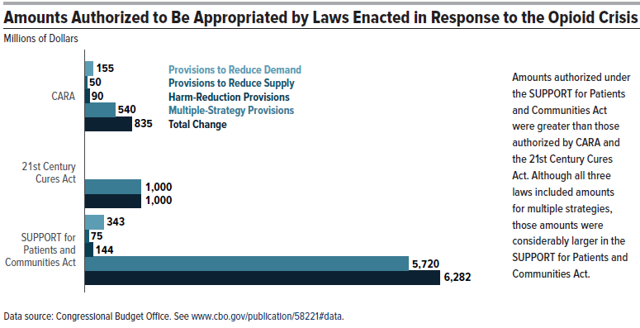
- Less opioid prescription - Change in strategies of supply control - three laws between 2016 and 2018: - CARA (2016) - 21st Century Cures Act (2016) - SUPPORT for Patients and Communities Act (2018) - 2017: framework of HHS to combat the opioid crisis - 2022: Overdose Prevention Framework by the FAD
Measures
Notes:
It‘s an option for doctors to prescript less opioid or to use less opioid in therapie, but as I mentioned at the beging, opioids have advantages in clinical use.
For the Authorities the current fentanyl crisis forced them to change their strategies concerning supply control. Pardo and Reuter mentioned that before fentanyl, it was resonable for the prosecutors to focus on raising prices and restricting availibility to reduce consumption and minimizing the violence and disorder around street markets. But today, a more important goal is to reduce the toxicity of the supply and thus the number of drug overdoses. This change is necessary due to the fact that there are multiple labs and the internet offers a bigger destribution network. Which means that shutting down a single lab or arresting a distribution ring will not be enough to disrupt the importation of fentanyl.
In response to the opioid crisis, three laws were enacted between 2016 and 2018: the Comprehensive Addiction and Recovery Act (CARA) of 2016, the 21st Century Cures Act in 2016 and the Substance Use-Disorder Prevention that Promotes Opioids Recovery and Treatment (SUPPORT) for Patients and Communities Act in 2018.
The US Department of Health and Human Services (HHS) implemented a framework in 2017 to combat the opioid crisis. Based on a five-point strategy they improved access to service for opioid addiction prevention, treatments, and recovery. 1. provide naloxone-based medications that can reverse an overdose, 2. enhance public data collection and reporting, 3. encourage a grdunbreaking study that advances the understanding of pain and addiction, 4. advance pain management techniques to find alternatives to opioid for treating pain.
In 2022 the Food and Drug Administration (FAD) unveiled the Overdose Prevention Framework, a strategy aimed at preventing drug overdoses, decreasing death rate, and addressing the significant effects of addiction to the populace.

Slide 12
- providing equipment (e.g. test stripes) - non-pharmacological treatments in case of mental health problems
Measures
Notes:
Today, bars and restaurants in the US offer free fentanyl test and Naracan, a naloxone-based drug that reverses an opioid overdose.
An other measure is to invest more in non-pharmacological treatments in case of mental health problems to avoid the risk of an opioid use disorder. Options are for example community interventions, educational prevention programs, psychotherapy, or coping skills counselling.

Slide 13
Conclusion

Slide 14
“Without a doubt, fentanyl is a drug that warrants consideration due to the nature of its effects; despite its significant potential in various fields of medicine, recreational use of this substance carries greater risks than those associated with other drugs. The interplay between drug accessibility and user motivations underscores the urgent need for educational efforts to mitigate the impact of this potent opioid on society.” Borrego-Ruiz
Conclusion
Notes:
To conclude I would end with a quote of Alejandro Borrego-Ruiz, that sums quite well the current situation.

Slide 15
Discussion

Slide 16
In your opinion, which measures are successful to avoid opioid deaths? What else can be done against opioid abuse?
Discussion

Slide 17
Borrego-Ruiz, Alejandro, (2024) „A holistic review of fentanyl use and its impact on public health“, In: Current Addiction Research 8, Nr. 2, 12.2024. Centers for Disease Control and Prevention, (2024) „Understanding the Opioid Overdose Epidemic“. Overdose Prevention, URL: https://www.cdc.gov/overdose-prevention/about/understanding-the-opioid-overdose-epidemic.html. Congressional Budget Office, (2022) „The Opioid Crisis and Recent Federal Policy Responses“. Ibrahim, Faycal, (2024) „Unraveling the Complexity of the Opioid Crisis: Challenges and Strategies in Tackling Fentanyl and Prescription Opioid Abuse“, In: https://pppescp.com/2024/05/13/unraveling-the-complexity-of-the-opioid-crisis-challenges-and-strategies-in-tackling-fentanyl-and-prescription-opioid-abuse/. Kerr, Thomas, (2019) „Public Health Responses to the Opioid Crisis in North America“, In: Epidemiol Community Health 73, Nr. 5, 1.5.2019. Krausz, Reinhard M.; Nikoo, Mohammadali; Jang, Kerry; and Choi, Fiona, (2021) „The North American Overdose Crisis and the European-American “Fentanyl and Treatment Gap”“, In: European Addiction Research 27, Nr. 4, 18.3.2021. Pardo, Bryce, and Reuter, Peter, (2020) „Enforcement strategies for fentanyl and other synthetic opioids“, Published by Brookings Institution, The opioid crisis in America, domestic and international dimensions.
Sources

Slide 18
Thank you for your attention

